Slide 1
New Interactive Puzzle Game Evaluation
KEY
TAKEAWAYS

Slide 2
Agenda
Introduction and
Tools Used
Active Users and Retention
Stickiness – Longevity and Consistency
Conversion and Purchasing
Recommendation
Summary

Slide 3


Introduction and Tools Used
Tools Used:
1. R Studio used for data Import, Cleaning & Analysis
2. Tableau – Used for further Analysis
Initial Data Issues Found:
1. Significant ‘Activity’ & ‘Purchase’ data missing
2. Impossible ‘Match’ data results
3. Significant Outliers present
Issue Handling:
1. Imputed data w/ meta data of similar records
2. Altered all 0 and -1 records to be 1
3. Identified and labeled outliers

Slide 4
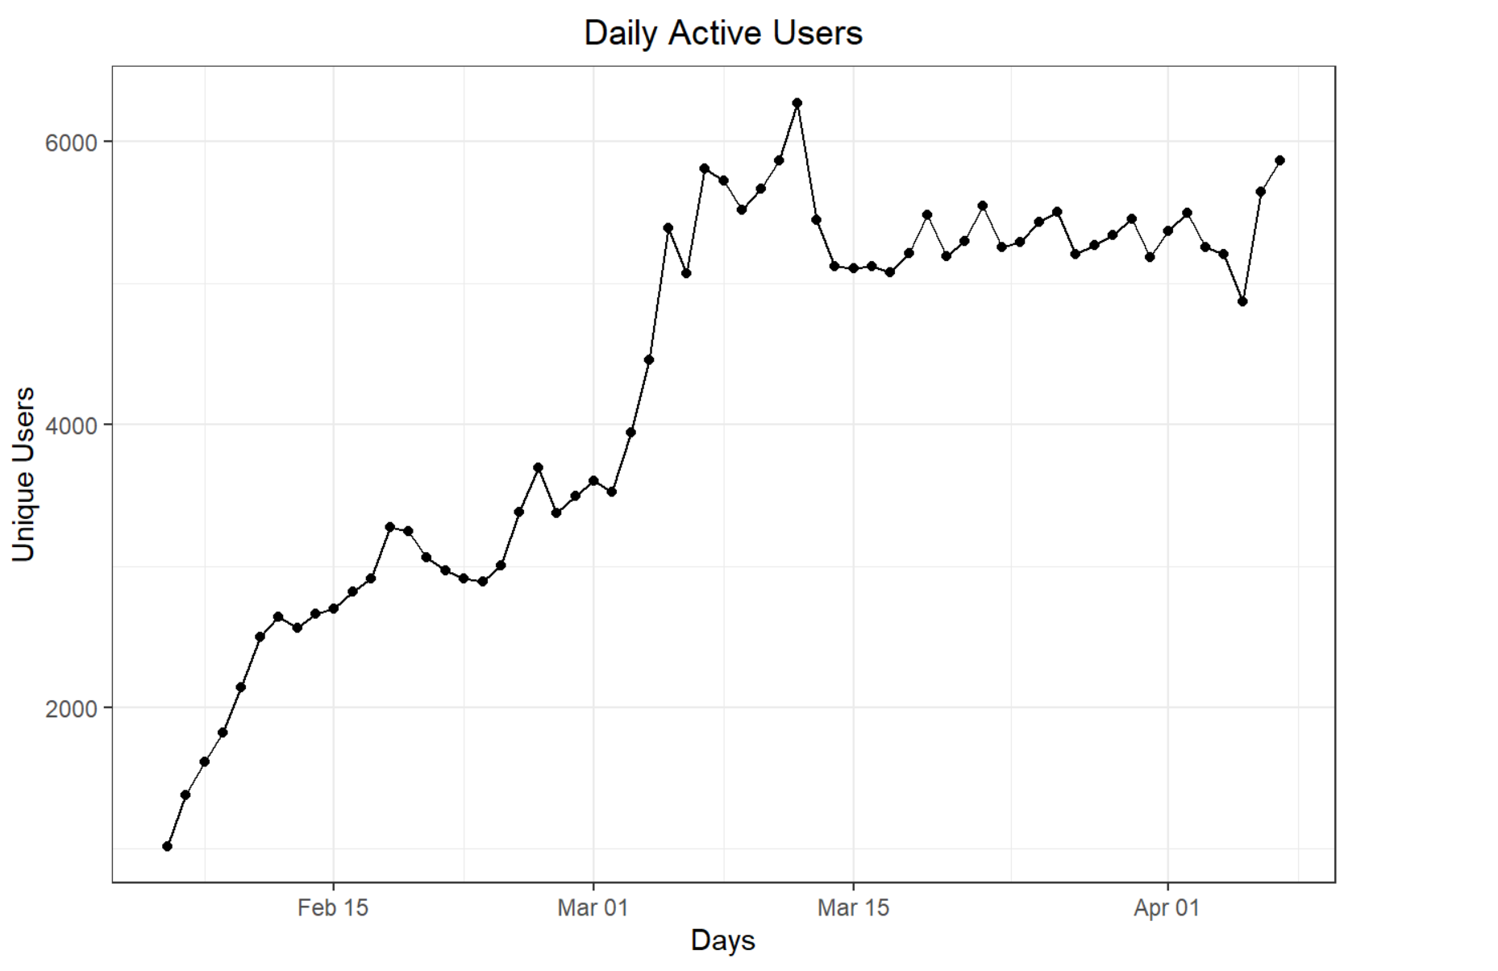
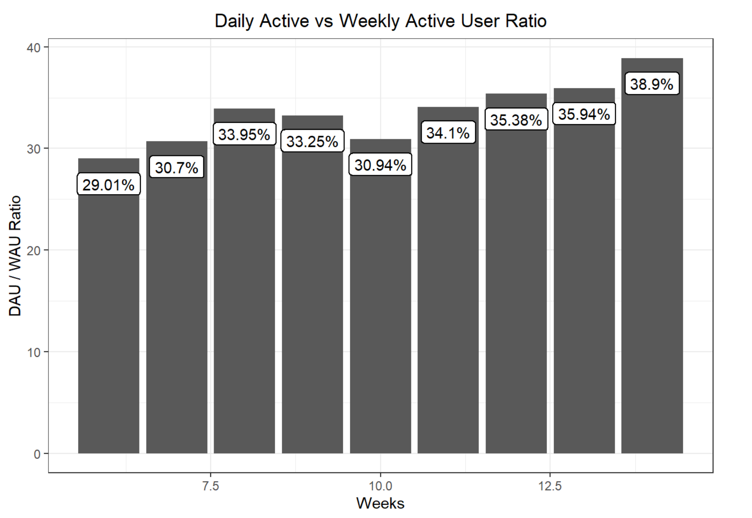
Active Users and Retention
What’s Shown?
Key Takeaways
Left Plot
Daily Active Users in general
Right Plot
DAU / WAU for all 9 weeks
Showing steady growth and acquisition which is encouraging
but retention/conversion questions remain
Small sample size for April but heading in the right direction
due to good influx of new users overall

Slide 5
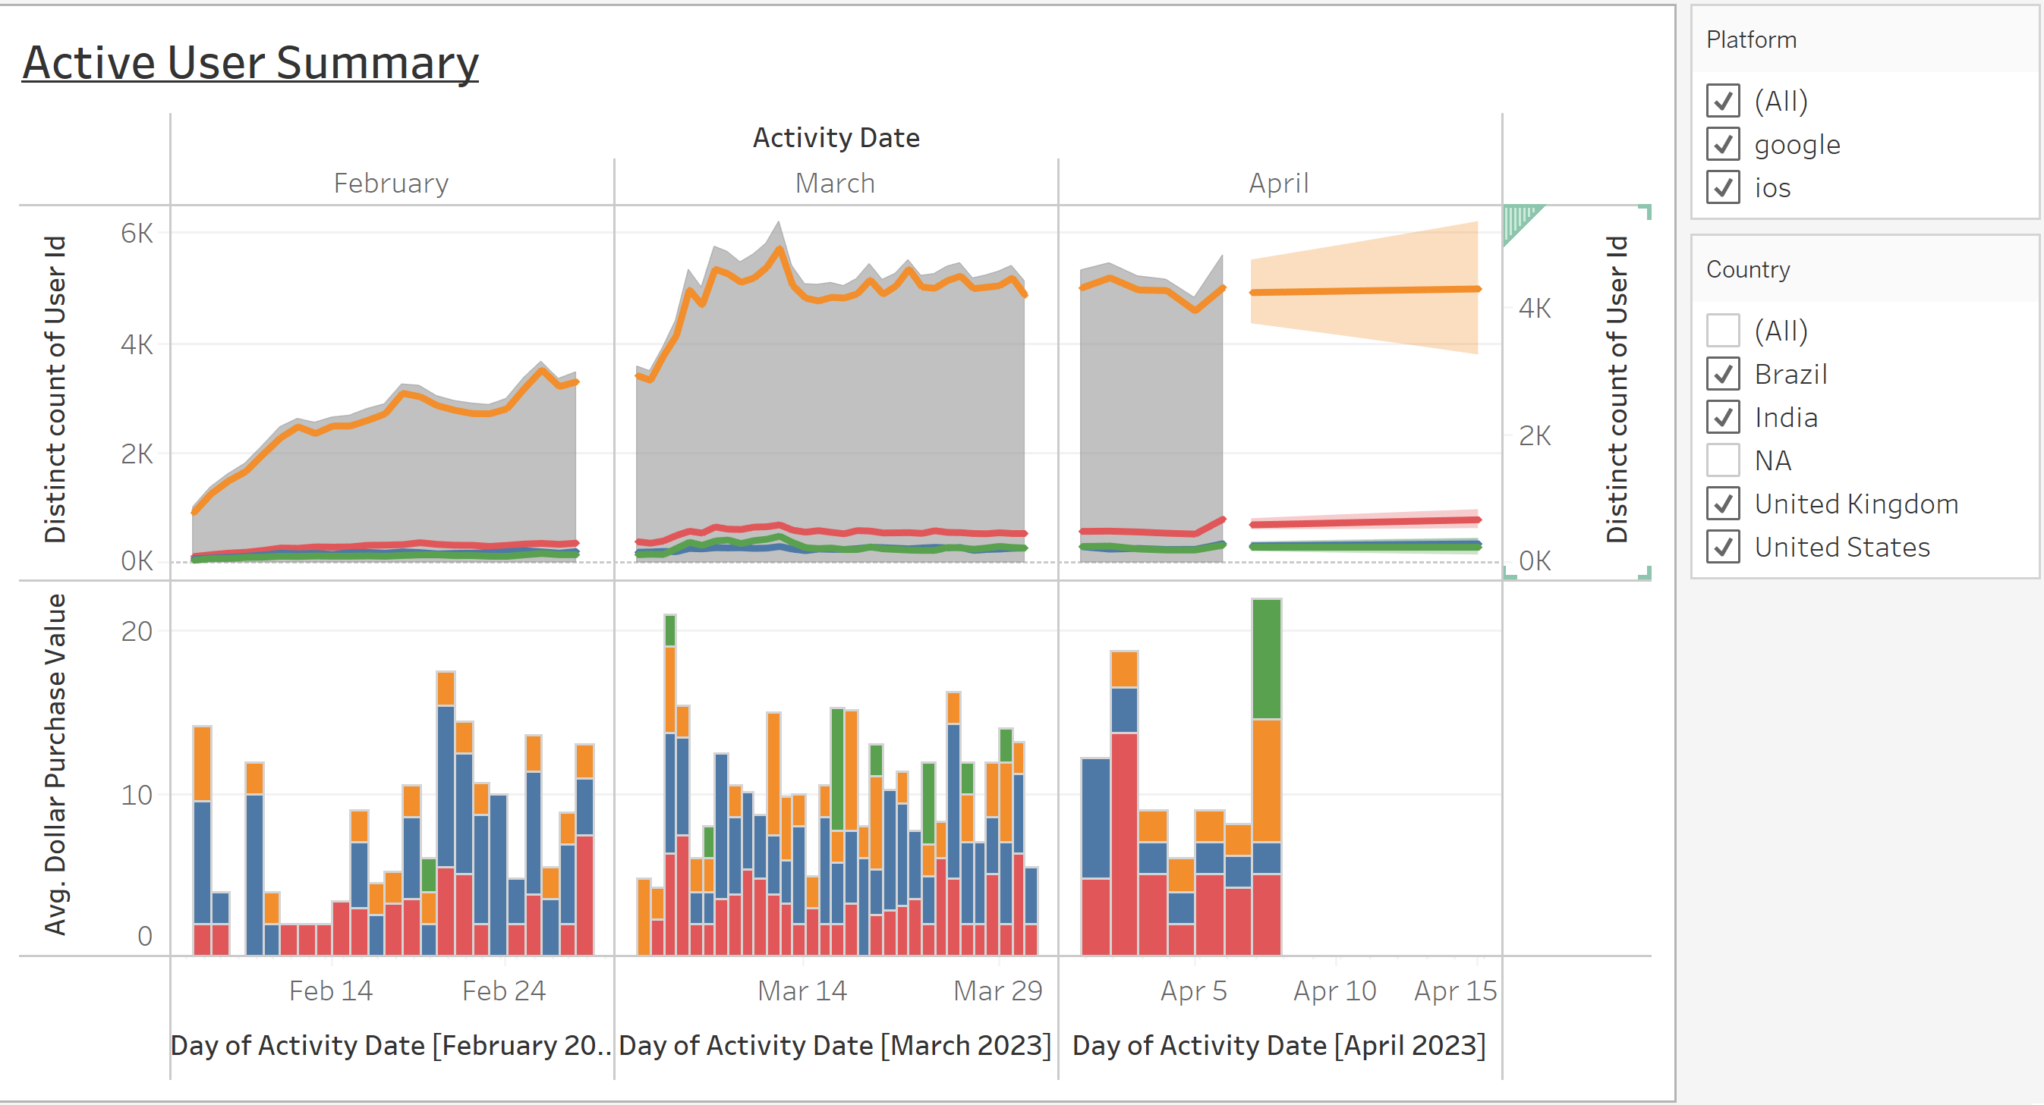
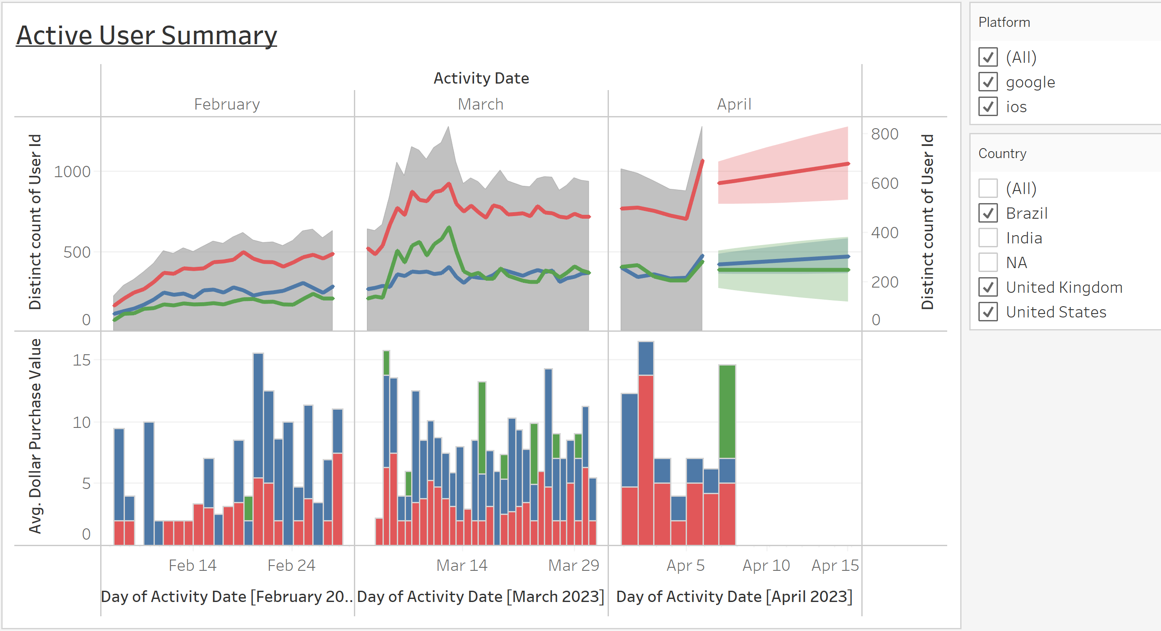
Active Users and Retention
What’s Shown?
Key Takeaways
Left Plot
Daily Active Trend with all countries
included
Second Plot
Daily Active Trend excluding India
US and UK grow at a much more gradual rate
These countries are more responsible for purchasing in
game products

Slide 6
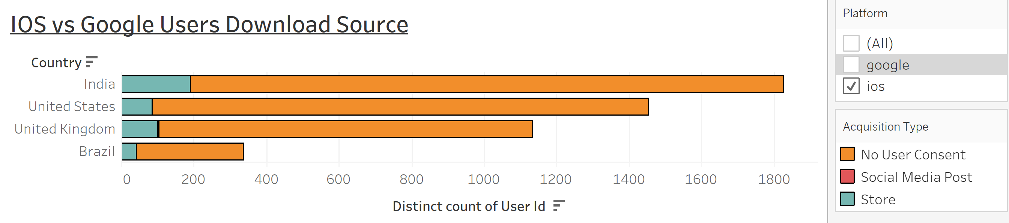
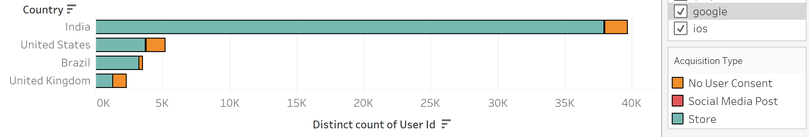
Active Users and Retention

Slide 7
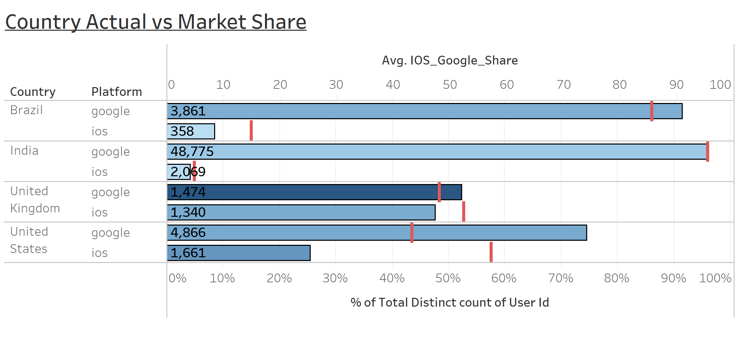
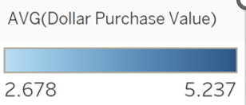
Active Users and Retention
What’s Shown?
Key Takeaways
First 2 Plots (Previous Slide)
User counts by acquisition type and country
Last Plot (Above)
Our user distribution compared to actual
market share by platform
Lack of interest and commitment from IOS users in general
Taking out population bias we can see we are missing the
mark in the US and UK specifically with IOS users

Slide 8
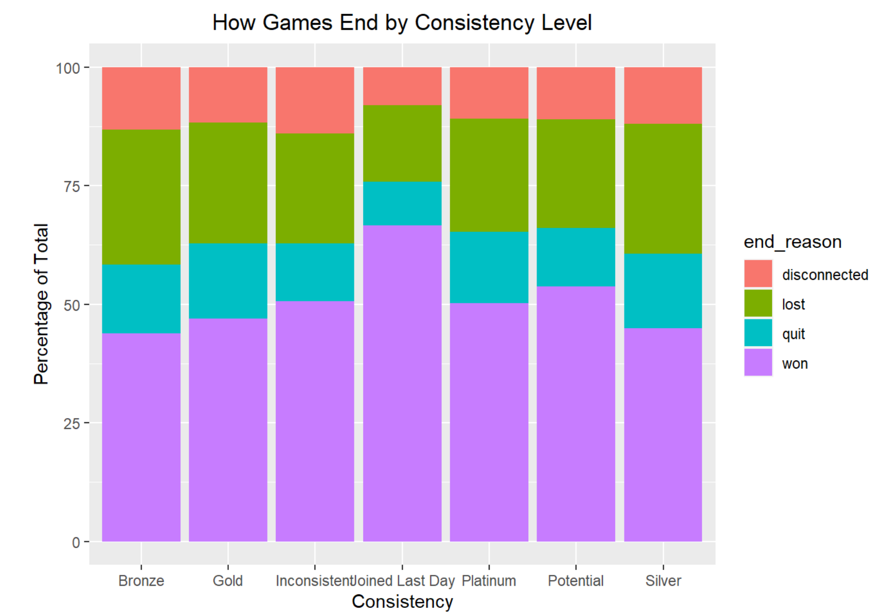
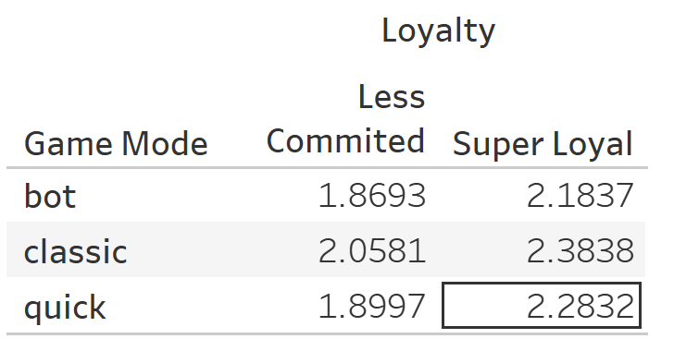
Stickiness Longevity and Consistency
Longevity = Latest Day Active / Days Since Download
Consistency = # of Days Active / Days Since Download
Loyalty = Combination of exceling at both (>75%)
What’s Shown?
Top Plot
Game resolution counts by consistency levels
Bottom Table
Game mode averages for loyal and un-loyal users
Key Takeaways
Users win across the board showing potential over ease
Loyal users tend to challenge themselves more with quick
and bot modes

Slide 9
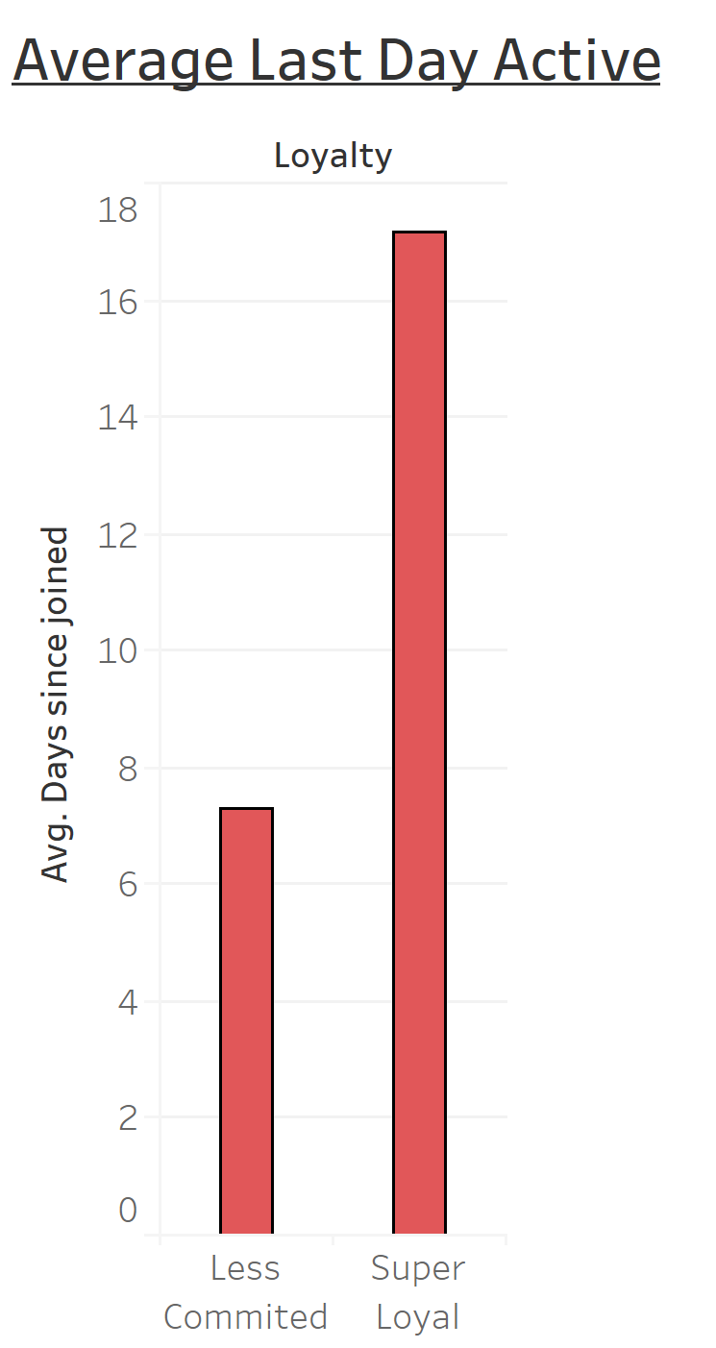
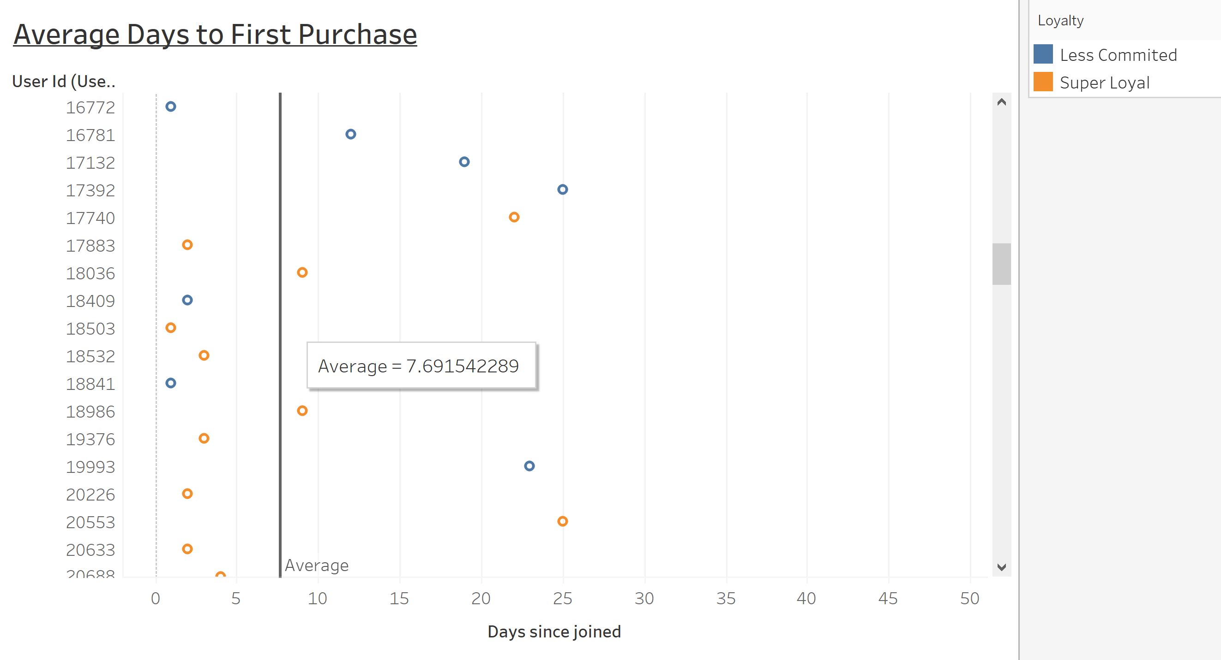
Conversion and Purchasing
What’s Shown?
Key Takeaways
First Plot
All purchasers by days to make first purchase
Highlighted as committed and less committed users
Second Plot
Average last day recorded active after joining
Users take on average 7.69 days after downloading to
make first purchase if at all
Less committed players are not reaching that threshold

Slide 10
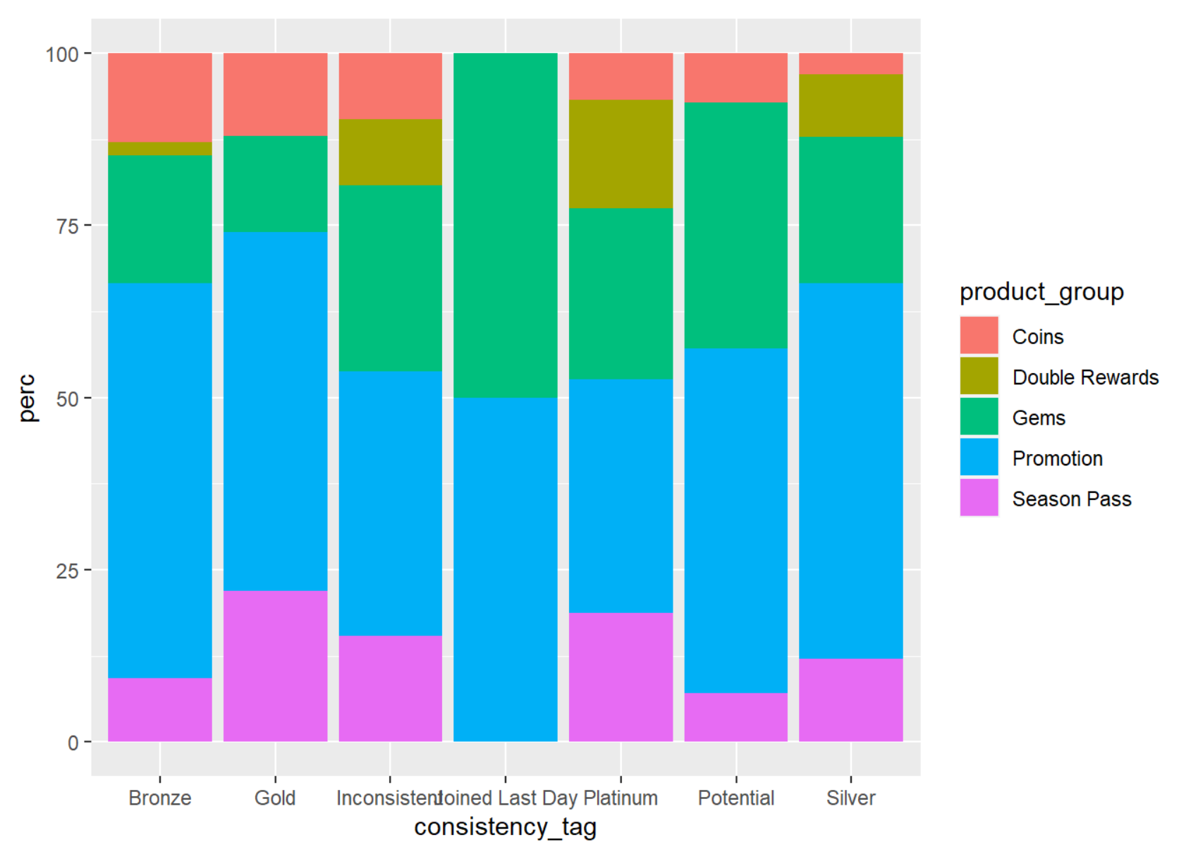
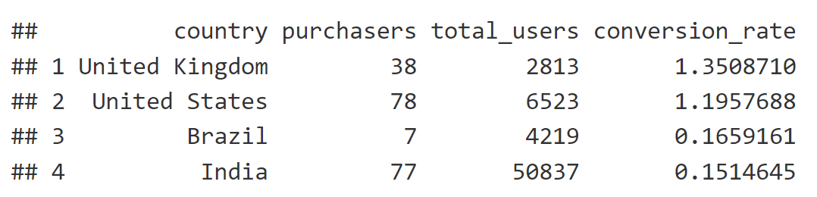
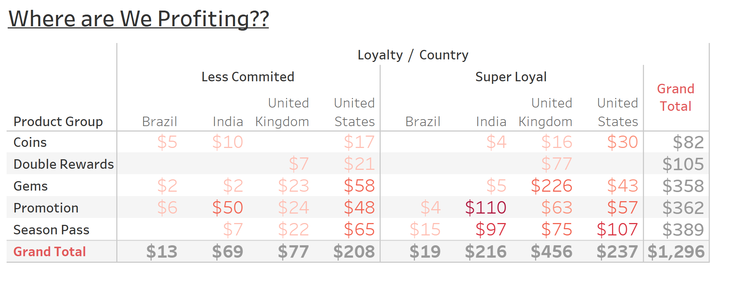
Conversion and Purchasing
What’s Shown?
Key Takeaways
Left Graphic
User consistency purchase types
Top Right Table
Conversion Rate by country all below 2%
Bottom Right Table
Product profit potential significantly higher with loyal users
Conversion rates are low across the board but slightly better in US & UK
Profits are nearly double amongst loyal consumers especially with promotions and season passes
New Users tend to purchase gems and promotions

Slide 11
Recommendation Summary
The Situation at hand:
1. We are missing the mark on IOS user attraction and committal
2. US and UK users are leading the way in purchasing even with lower users than expected
3. We are illustrating good growth and retention but a very low conversion rate
4. Users take on average 7.69 days to make a first purchase if at all
5. Win rates are extremely high across the board and loyal users have increased rates of quick and bot game modes (challenge modes)
6. There are also minor increases of disconnection issues in unsatisfied users

Slide 12
Recommendation Summary
My recommendations:
1 & 2
Allocate resources to address marketing towards IOS, US, and UK including Social Media approach
3 & 4
Implement a 1-2 week promotion or free trial (season pass) to get users involved including daily rewards and incentives
5 & 6
Allocate Development resources to optimize server quality and implement choice of competition level (Easy, Medium, Hard) or different timed versions to increase difficulty for players seeking a challenge
Overall:
Implement alterations and extend timeline of trial to collect more data

